Slide 1
Non-deterministic Finite Automata (NFA)

Slide 2
Outline
Recap on DFA
NFA definition, examples

Slide 3
Deterministic Finite Automata - Definition
A Deterministic Finite Automaton (DFA) consists of:
Q ==> a finite set of states
∑ ==> a finite set of input symbols (alphabet)
q₀ ==> a start state
F ==> set of accepting states
δ ==> a transition function, which is a mapping between Q x ∑ ==> Q
A DFA is defined by the 5-tuple:
{Q, ∑ , q₀,F, δ }

Slide 4
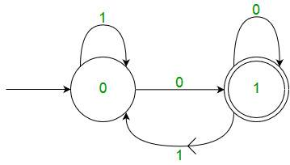
Deterministic Finite Automata
In a DFA, for a particular input character, the machine goes to one state only.
A transition function is defined on every state for every input symbol.
Also in DFA null (or ε) move is not allowed, i.e., DFA cannot change state without any input character.
For example, below DFA with Σ = {0, 1} accepts all strings ending with 0.
Courtesy:https://www.geeksforgeeks.org/introduction-of-finite-automata/
Notes:
https://www.geeksforgeeks.org/introduction-of-finite-automata/

Slide 5
Non-deterministic Finite Automata (NFA)
A Non-deterministic Finite Automaton (NFA)
is of course “non-deterministic”
Implying that the machine can exist in more than one state at the same time
Transitions could be non-deterministic
1
q_{j}
q_{i}
…
Each transition function therefore maps to a set of states
1
q_{k}

Slide 6
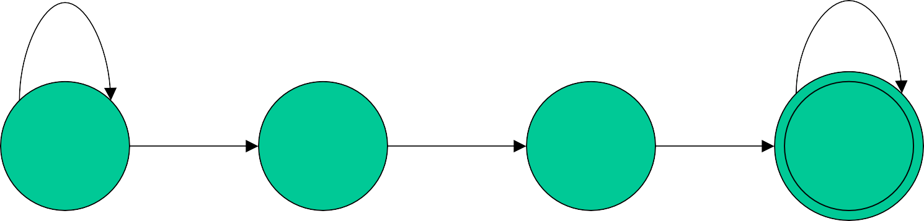
Example of NFA
0,1
0,1
start
1 0, λ
1
q₁
q₂
q₃
q₄
Difference with DFA
Can move to more than 1 states, after reading a character (E.g., at q₁, on reading 1, we can move to q₁ or q₂; or
Nowhere (δ( qi,a) may be empty, meaning that there is no transition defined for this specific situation), at q₂, on reading 1, nowhere to go!)
Can move to another state without reading anything (E.g., at q₂, the symbol λ on arrow pointing at q₃ indicates that we can move to q₃ without reading anything)
Notes:
http://www.cs.nthu.edu.tw/~wkhon/toc07-lectures/lecture3.pdf

Slide 7
Non-deterministic Finite Automata (NFA)
A Non-deterministic Finite Automaton (NFA) consists of:
Q ==> a finite set of states
∑ ==> a finite set of input symbols (alphabet)
q₀ ==> a start state
F ==> set of accepting states
δ ==> a transition function, which is a mapping between Q x ∑ ==> subset of Q
An NFA is also defined by the 5-tuple:
{Q, ∑ , q₀,F, δ }

Slide 8
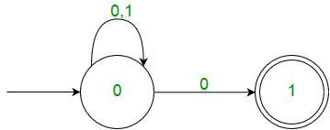
Non-deterministic Finite Automata (NFA)
δ: Transition Function
δ: Q X (Σ U λ ) --> 2 ^ Q.
2^{Q} is the power set of Q (the set of subsets of Q).
As you can see in transition function is for any input including null (or ε), NFA can go to any state number of states. For example, below is a NFA with Σ = {0, 1} accepts all strings ending with 0.)
Courtesy:https://www.geeksforgeeks.org/introduction-of-finite-automata/

Slide 9
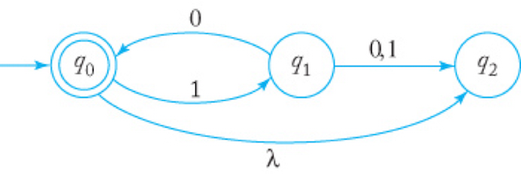
Example of NFA
Several edges with the same label originate from one vertex.
It has a λ-transition.

Slide 10
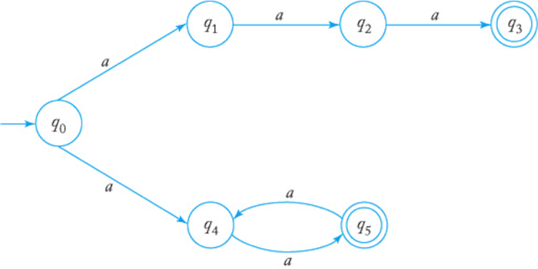
Example of NFA
Several edges with the same label originate from one vertex.
It has a λ-transition.

Slide 11
Differences: DFA vs. NFA
But, DFAs and NFAs are equivalent in their power to capture langauges !!
DFA
All transitions are deterministic
Each transition leads to exactly one state
For each state, transition on all possible symbols (alphabet) should be defined
Accepts input if the last state visited is in F
Sometimes harder to construct because of the number of states
Practical implementation is feasible
NFA
Some transitions could be non-deterministic
A transition could lead to a subset of states
Not all symbol transitions need to be defined explicitly (if undefined will go to an error state – this is just a design convenience, not to be confused with “non-determinism”)
Accepts input if one of the last states is in F
Generally easier than a DFA to construct
Practical implementations limited but emerging (e.g., Micron automata processor)

Slide 12
How to use an NFA?
Input: a word w in ∑*
Question: Is w acceptable by the NFA?
Steps:
Start at the “start state” q₀
For every input symbol in the sequence w do
Determine all possible next states from all current states, given the current input symbol in w and the transition function
If after all symbols in w are consumed and if at least one of the current states is a final state then accept w;
Otherwise, reject w.

Slide 13
What is accepted by NFA?
Let M be an NFA
(Informally,) M accepts a string w if there is at least one way to move from the start state to a final state according to the transition arrows, such that the concatenation of the true characters (that is, ignoring ε) used by the transition is equal to w

Slide 14
What is accepted by this?
0,1
0,1
start
1
0, λ
1
q₁
q₂
q₃
q₄

Slide 15
What is accepted by this?
0,1
0,1
start
1
0, λ
1
q₁
q₂
q₃
q₄
Answer: Binary String containing atleast two 1’s

Slide 16
What is accepted by this?

Slide 17
What is accepted by this?
Answer: L(M)= {(10)^{n} : n>=0}

Slide 18
What is accepted by this?

Slide 19
What is accepted by this?
Answer:L(M)={{a³ } U {a^{2n}:n>=1}}

Slide 20
NFA for strings containing 01
Regular expression: (0+1)*01(0+1)*
Why is this non-deterministic?
Q = {q₀,q₁,q₂}
Σ = {0,1}
start state = q₀
F = {q₂}
Transition table
0,1
0,1
start
0
1
q₀
q₁
q₂
Final
state
symbols
0
1
What will happen if at state q₁ an input of 0 is received?
q₀
{q₀,q₁}
{q₀}
states
q₁
Φ
{q₂}
*q₂
{q₂}
{q₂}
Remains in the state q1

Slide 21
What is an “error state”?
Note: Omitting to explicitly show error states is just a matter of design convenience (one that is generally followed for NFAs), and i.e., this feature should not be confused with the notion of non-determinism.
A DFA for recognizing the key word “while”
An NFA for the same purpose:
w
h
i
l
e
q₀
q₁
q₂
q₃
q₄
q₅
Any other input symbol
q_{err}
Any symbol
w
h
i
l
e
q₀
q₁
q₂
q₃
q₄
q₅
Transitions into a dead state are implicit
Input: wohilueds?

Slide 22
Discussion Questions
Please refer
TB_A1_NFA_Q.doc
TB_A1_NFA_Ans.doc

